Slide 1
Simple class creation
Introduction to Object Oriented programming

Slide 2
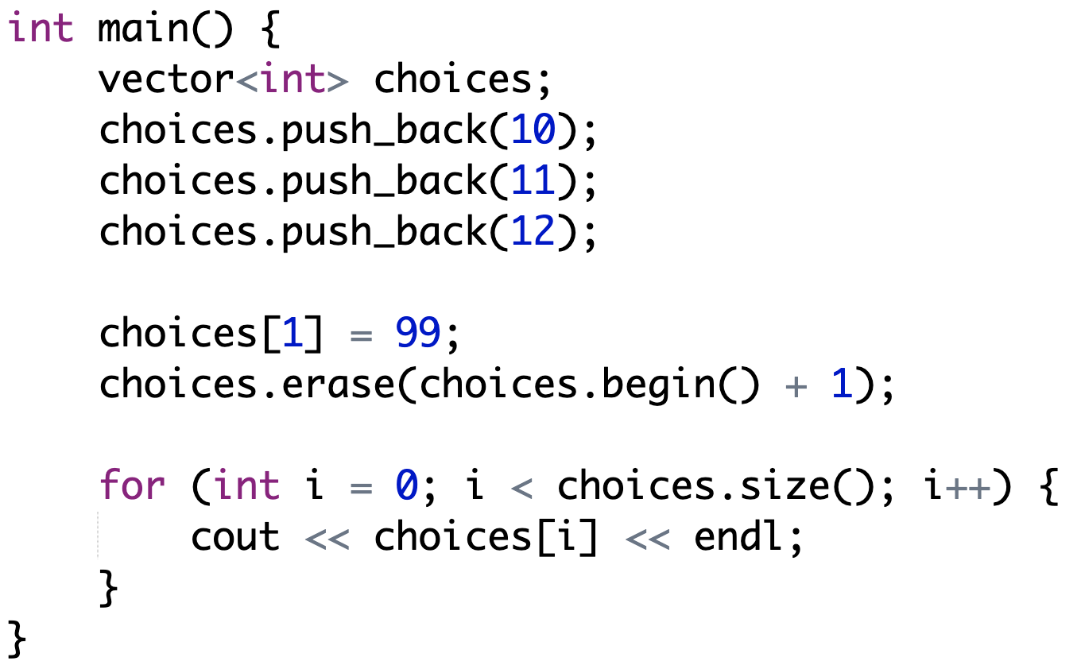
Example: Working with vector (Dynamic array)

Slide 3
General guidelines
Each class should be split into 2 files
ClassName.h (declaration)
ClassName.cpp (implementation)
For example, suppose we have a class named Student
We should have 2 files
Student.h for declaration
Student.cpp for implementation

Slide 4
Random

Slide 5
Example Random number
#include <stdlib.h>
// Khởi tạo bộ sinh số ngẫu nhiên
srand(time(NULL));
// Sinh số nguyên ngẫu nhiên
cout << rand();

Slide 6
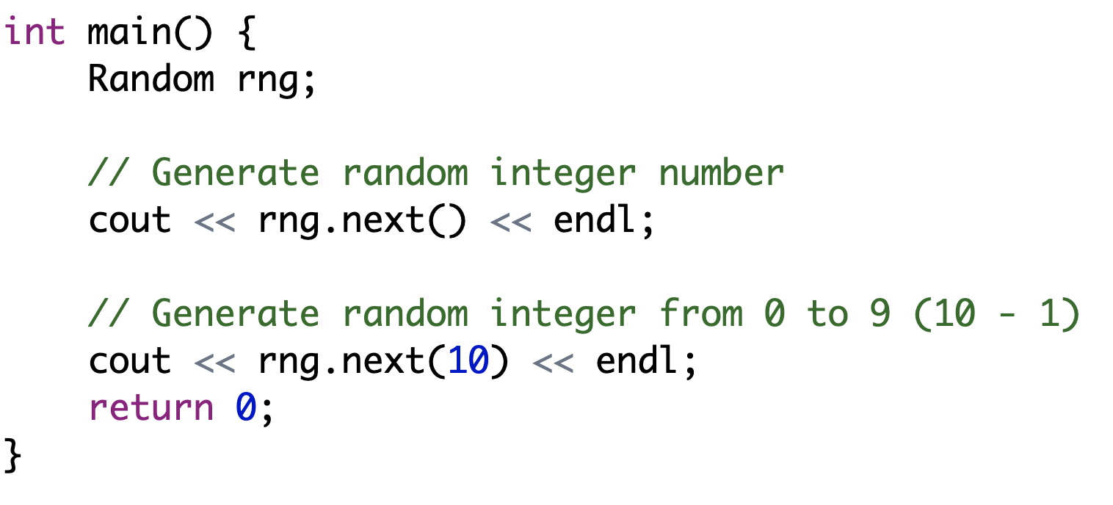
01. Project Random
Implement a class for generating random number named Random

Slide 7
Dice

Slide 8
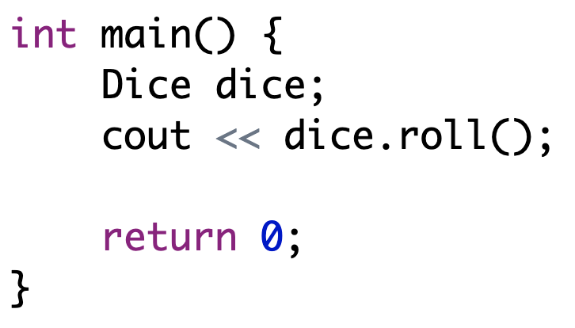
02. Project Dice
Create a class that simulates a dice

Slide 9
Dice’s enhancement
How to know the number of times a dice has been rolled?
Roll infinitely until enter 0
What is the average number that we get from all the rolls?
Print out all the counts for all the values of one dice
For example
1: 6 times, 2: 4 times, 3: 0 times, 4: 7 times….
_counts[7] = [-1, 0, 0, 0, 0, 0, 0] _count[1]++

Slide 10
Parsing string into integer

Slide 11
Example: Parsing string into number
string value = “12”;
int number1 = stoi(value);
int number2 = stof(value);

Slide 12
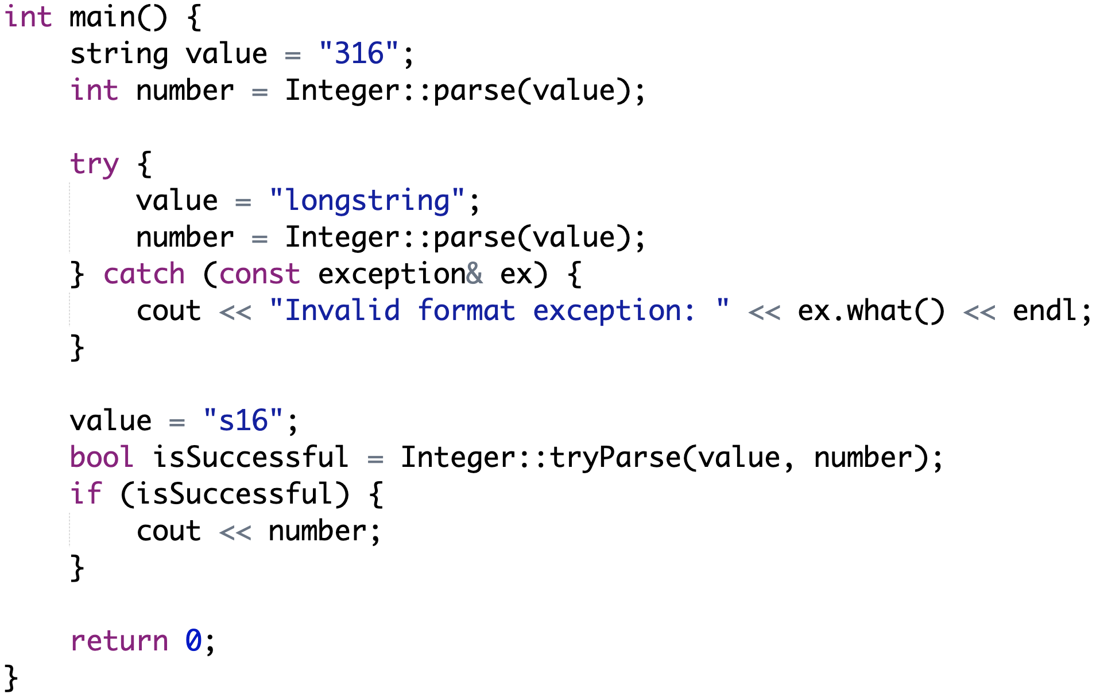
03. Project Integer

Slide 13
Integer’s enhancements (1)
Check if an integer is a prime number
Integer::isPrime(int)
Check if an integer is a perfect number (sum of all n’s divisors = 2*n ) Integer::isPerfect(int)
For example: 6 has 4 divisors [1, 2, 3, 6],
1 + 2 + 3 + 6 = 2 *6 ==> 6 is a perfect number

Slide 14
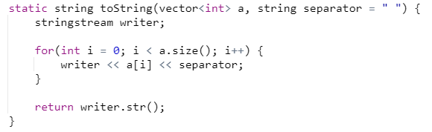
Integer’s enhancements (2)
3. Convert a vector of int into string (only do this if already introduced vector)
Notes:
“Hello” + “world” + “good morning” + “have a nice day” “n - 1”
4 bytes * 4 pointer = 16bytes
String stream str()
“Hello world goood morning have a nice day”
Tiet kiem khong gian / speed - StringBuilder / StringBuilder - Builder Design Pattern

Slide 15
Parsing string into float

Slide 16
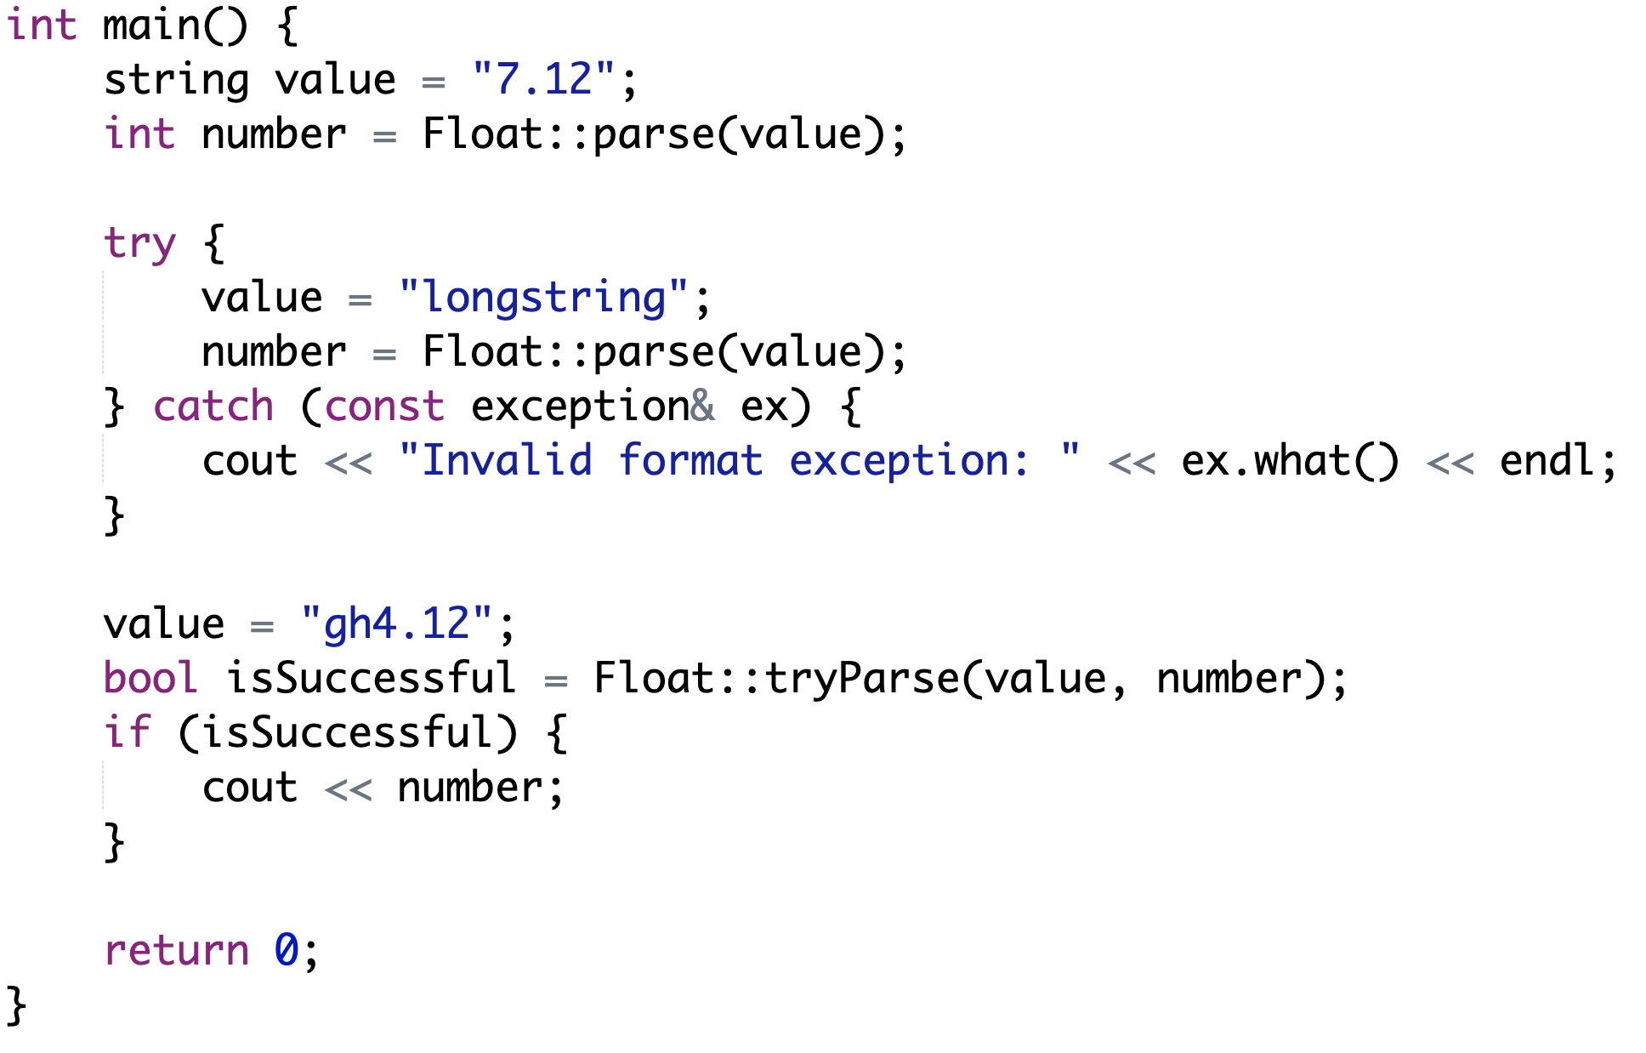
04. Project Float

Slide 17
String split

Slide 18
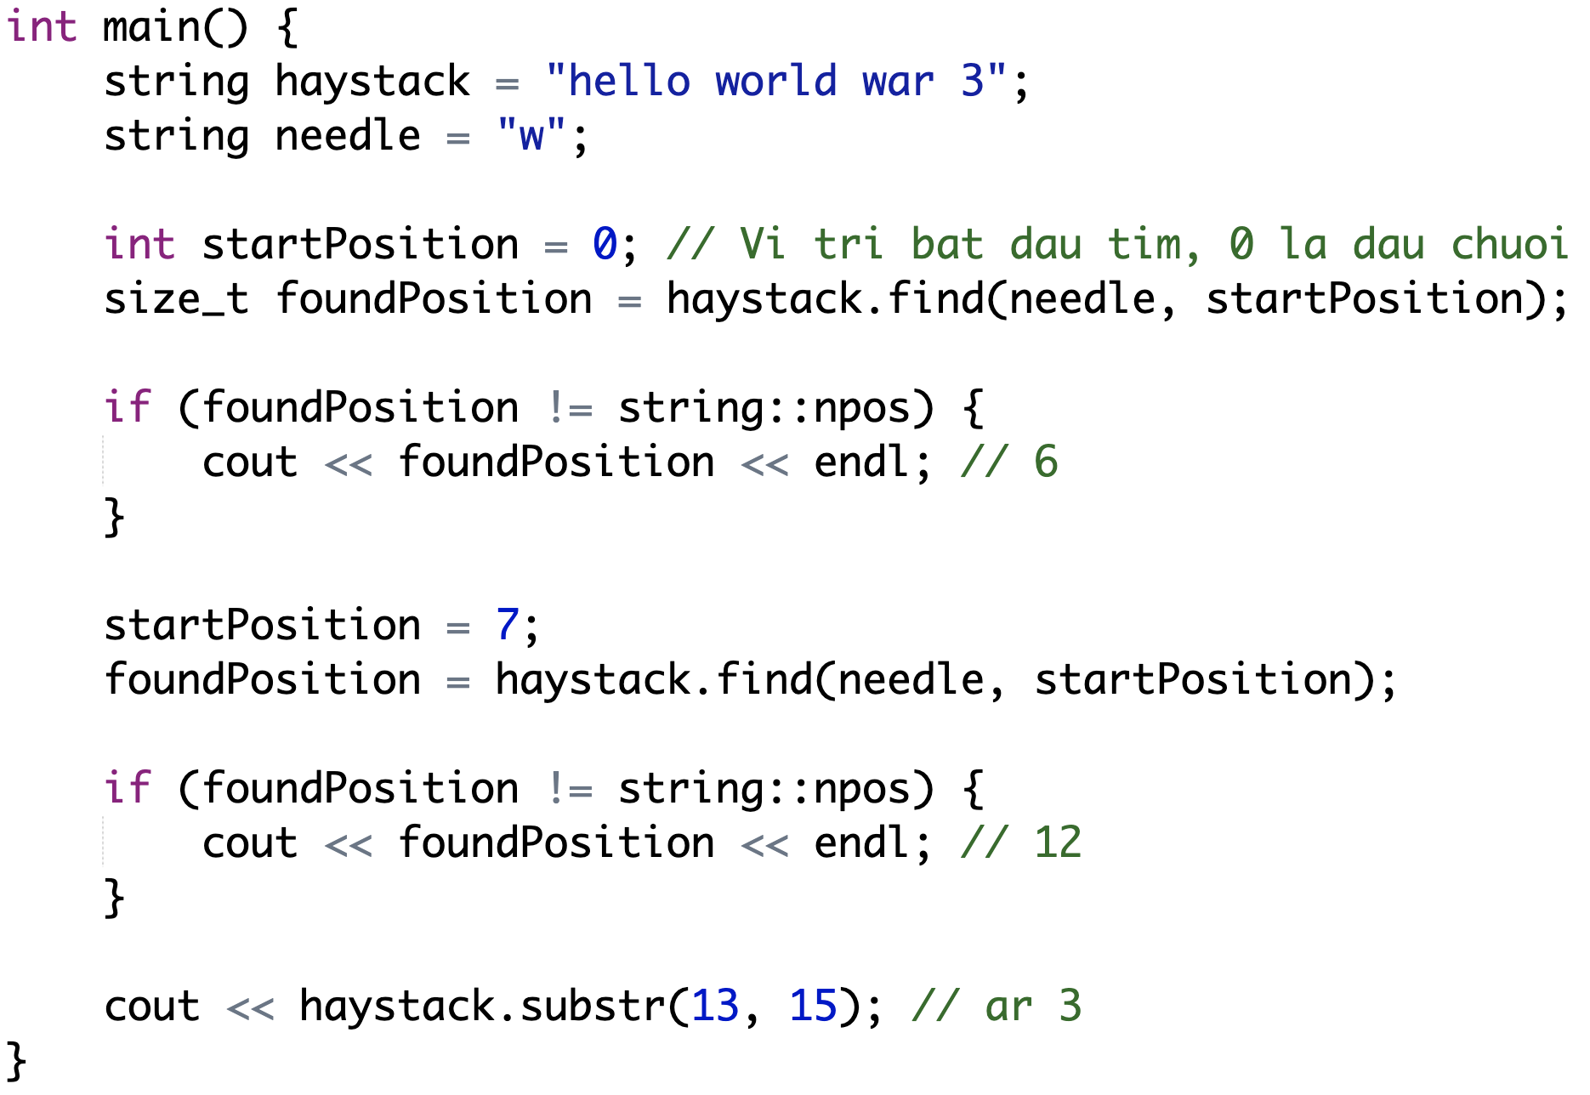
Example: Finding substring

Slide 19
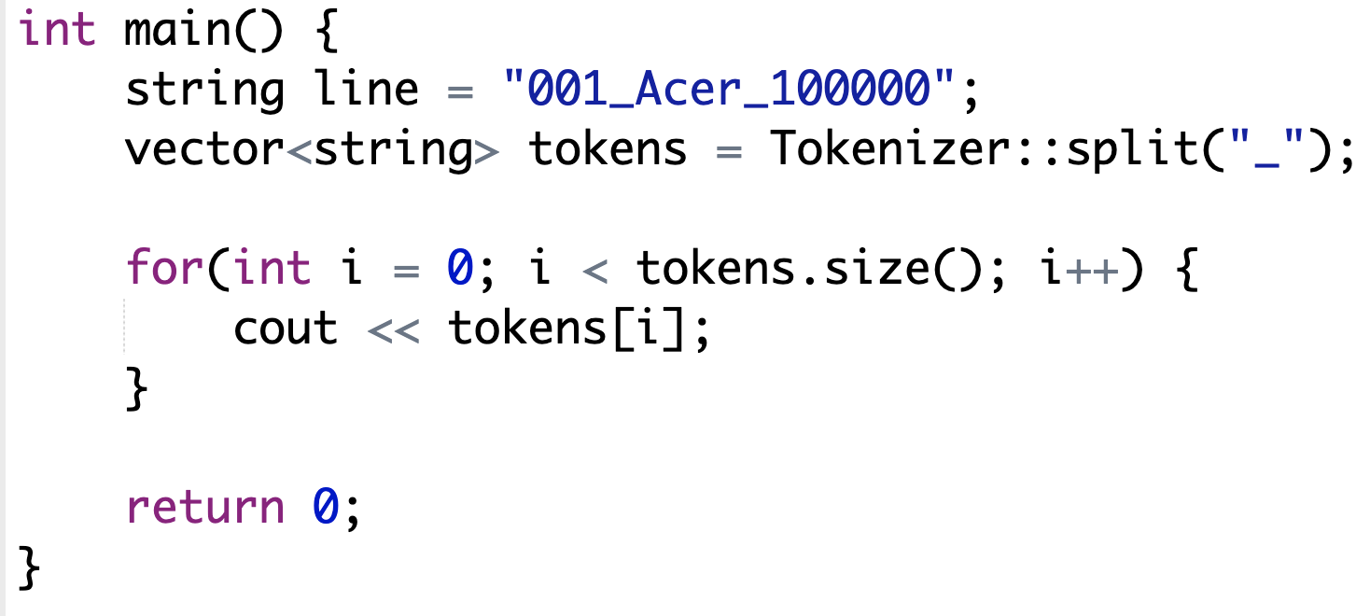
05. Project Tokenizer
Write a class that help split a string into vector of string
001
Acer
10000

Slide 20
Fake Name

Slide 21
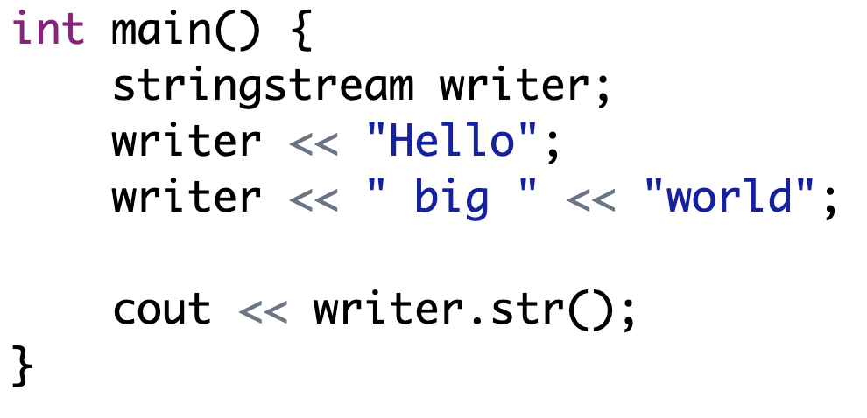
Example: Combining string

Slide 22
06. Project FakeName
Choose first name from this list:
https://vi.wikipedia.org/wiki/H%E1%BB%8D_ng%C6%B0%E1%BB%9Di_Vi%E1%BB%87t_Nam
Choose middle name from this list:
http://www.erct.com/4-ChiaSe/SuuTam/Tinh_danh-TEN_DEM.htm
Choose last name from this list
https://xltiengviet.fandom.com/wiki/T%C3%AAn_ng%C6%B0%E1%BB%9Di_Vi%E1%BB%87t_Nam
In main function, generate 20 fake names.

Slide 23
Hint
Fullname is the entity class for storing data. It should have 3 attributes: _firstName, _middleName, _lastName
FakeName is the business class, for generating data using next
Fullname FakeName::next()

Slide 24
Fake Address

Slide 25
07. Project FakeHcmAddress
Goto tiki.vn
Find list of district (choose 5)
Find list of ward for each district (choose 8 for each district)
Find list of street from each district (choose 5 - Google maps)
Create a combination from these elements
In main function, generate 20 fake HCM addresses

Slide 26
Hint
Address is the entity class for storing data. It should has 4 attributes:
_number: The number of the house (should be string because of something like this 22/34, 6 bis…). You may need a class named FakeHouseNumber which acts as a business class for generating house number.
_street: The name of the street.
_ward: string
_district: string
_city: string.
FakeHcmAddress is the business class for generating data
Address FakeHcmAddress::next()

Slide 27
Fake Tel

Slide 28
08. Project FakeVnTel
Pick an operator from this list and generate the rest:
https://quantrimang.com/danh-sach-dau-so-cac-mang-di-dong-o-viet-nam-133203
In main function, generate 20 fake VN tels
Note: Display of tel is different like 0909 222 888

Slide 29
Hint
Tel is just a string, no need for a class

Slide 30
Fake Email

Slide 31
09. Project FakeEmail
Prepare 10 biggest company domains like gmail.com, microsoft.com, apple.com, amazon.com....
Generate fake fullname, for example Tran Duy Quang, then choose one company domain, like apple.com, then generate fake email like tdquang@apple.com
(Hint: get substring, first letter of Firstname and Middle name)
In main function, generate 20 fake emails.

Slide 32
Hint
Email is just a string, no need for a class

Slide 33
Time

Slide 34
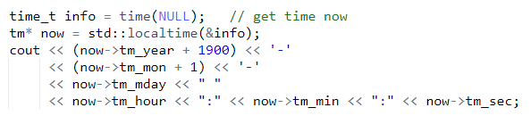
Example Get current time
#include <ctime>

Slide 35
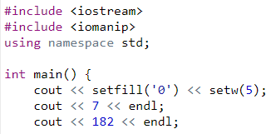
Example Set width of output
Output:
00007
182

Slide 36
10. Project Time
Time(): initialize with current time
Time(int, int, int): initialize using 3 components hour, minute, second
string toString(): output in this format “06:18:20”
Time Time::parse(string): convert a string like “06:18:20” into time
bool Time::tryParse(string, &Time)
bool Time::isValid(string)

Slide 37
Requirement
In main function, write code to test all of your class methods
What adjustment would you make to output time in 24 hour format (23:59:14) or in 12 hour format (11:59:14 PM)?

Slide 38
Date

Slide 39
11. Project Date
Date(): initialize with current date
Date(int, int, int): initialize using 3 components hour, minute, second
string toString(): output in this format “07/06/2020”
Date Date::parse(string): convert a string like “07/06/2020” into time
bool Date::tryParse(string, &Date)
bool Date::isValid(string)
bool Date::isLeapYear(int)

Slide 40
Requirement
In main function, write code to test all of your class methods
What adjustment would you make to output date in short format 06/07/2020 or in long format 06/07/2020?
What if your app is used in US, where 07/06/2020 is the correct format?

Slide 41
Fake Birthday

Slide 42
12. FakeBirthday
Birthday is just a date with some constraints
As of 11 November 2019, the oldest known living person is Kane Tanaka of Japan, aged 116 years, 313 days. (https://en.wikipedia.org/wiki/List_of_the_verified_oldest_people#:~:targetText=The%20oldest%20person%20ever%20whose,of%20116%20years%2C%2054%20days)
Generate birthday using function next
Date FakeBirthday::next()

Slide 43
FakeBirthday enhancement
Date FakeBirthday::next(int age)
Generate a random birthday with a specific age (which means you only have to generate random day and month only, the year can be inferred from age and current year)

Slide 44
Sequence

Slide 45
13. Project Sequence
This is a common problem from
Relational database like MySQL, Postgres for creating id
Hiding actual bills number from a store within a day
Suppose the first bill is numbered 1, the next is 2
If we look at a bill and see its number is 398, we can assume easily that this store has roughly 398 transactions, some store owners want to hide this
The bills must be in ascending order for the kitchen to know everything is okay, no bill is dropped

Slide 46
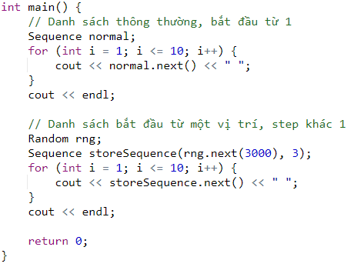

Requirement

